Slide 1
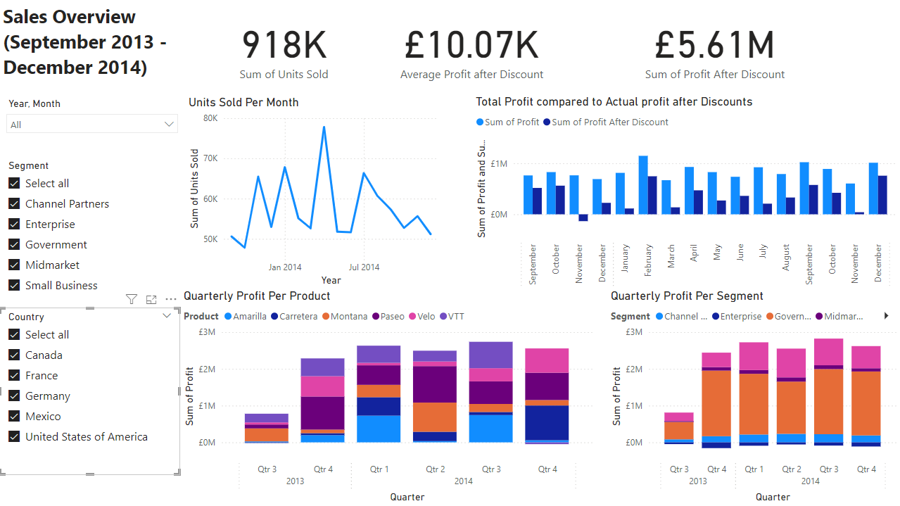
PowerBI Portfolio Project
An Overview into the process

Slide 2
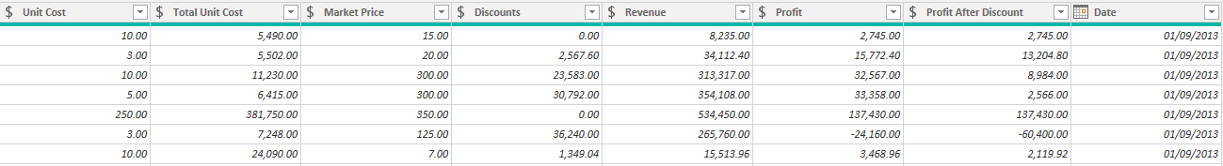
ETL (Explore, Transform, Load)
The sample data I acquired to use was not ready to analyse yet, as it required processing to make it easier to manipulate.
To begin, duplicate date columns and other irrelevant fields were removed to make navigation easier.
Certain fields (such as units sold and profit) would need to be converted into integer values and fixed decimal values, respectively.
I also made use of calculations and measures to add useful data columns not already provided, such as the total cost of the units sold in each record and the profit left over after discounts were deducted. I also introduced a measure to show the average profit amount overall for later on in my report.

Slide 3
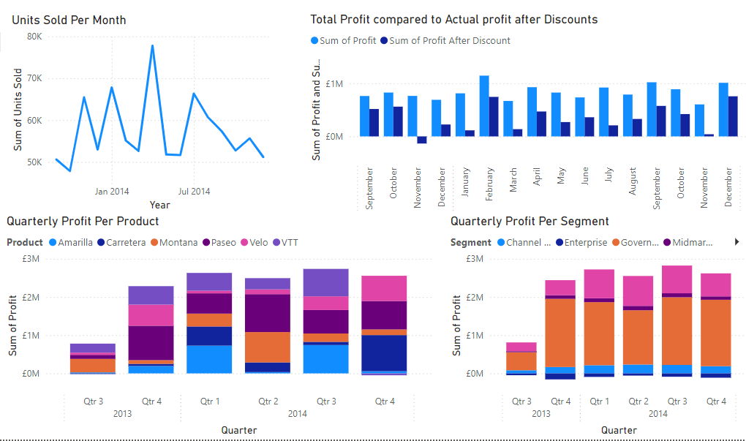
Four Charts for Four Questions
What do the total sales and profit trends over the years look like?
What is the product and segment generating the most profit?
How have discounts impacted the overall sales in this timeframe?
Which month has the highest sales performance?
The charts add to each other in their own way to help reveal insights. While some tables directly reveal more information that others, they all feed into each other. For instance, the number of units sold drops sharply in December, though the value from the sales in that period make it one of the top 3 most profitable months in the timeframe.

Slide 4
The Full Dashboard
This dashboard combines the charts I created into an interactive interface that adjusts in real time to filters seen at the left, allowing you to see results from different scales of time, across different countries and across individual profits and segments. KPI Cards at the top provide easily digested information on the most important data points – these too adjust based on the slicers.
Key Findings:
Sales to the enterprise segment are almost always a significant net loss for the business, even without factoring discounts. This indicates that the production costs for products they use are much higher than the price they are being sold at.
France and Germany alone provide 2.95 million pounds of profit (after discounts), 0.29 million more than the entire of North America combined. Further development into the West European market is highly recommended.
Sales to governments make up 5.53 million pounds of profit, by far being the largest source of income in the business.

